Slide 1



ML/DL for Everyone with
Lecture 12: RNN
Sung Kim <hunkim+ml@gmail.com> HKUST
Code: https://github.com/hunkim/PyTorchZeroToAll
Slides: http://bit.ly/PyTorchZeroAll

Slide 2

Call for Comments
Please feel free to add comments directly on these slides.
Other slides: http://bit.ly/PyTorchZeroAll
Picture from http://www.tssablog.org/archives/3280

Slide 3
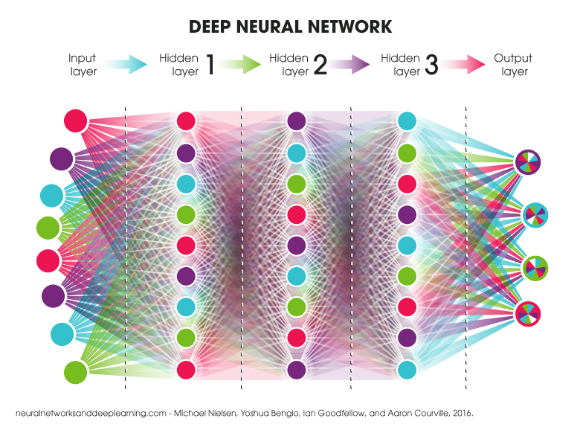
DNN, CNN, RNN
https://blog.ttro.com/artificial-intelligence-will-shape-e-learning-for-good/

Slide 4
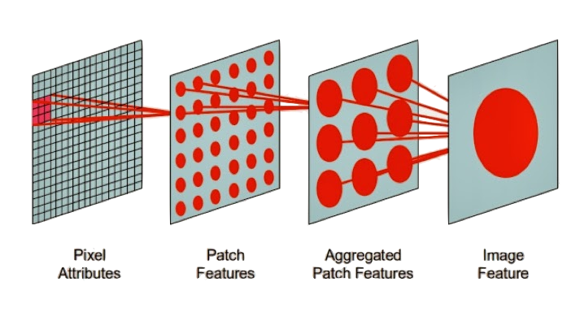
DNN, CNN, RNN
http://practicalquant.blogspot.hk/2013/10/deep-learning-oral-traditions.html

Slide 5
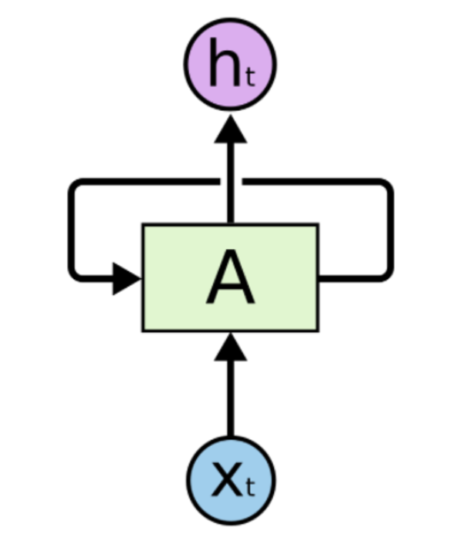
DNN, CNN, RNN
http://practicalquant.blogspot.hk/2013/10/deep-learning-oral-traditions.html

Slide 6
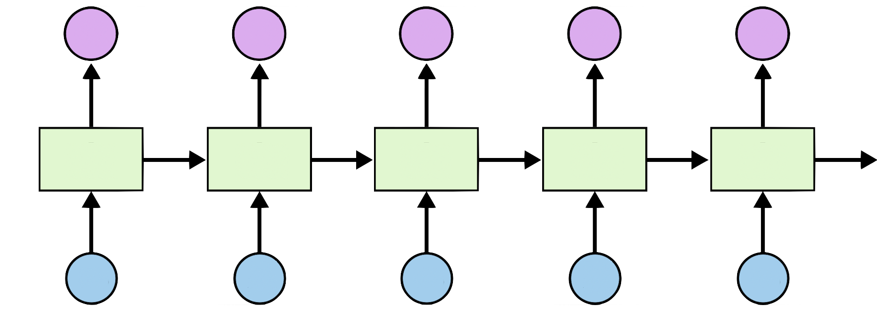

DNN, CNN, RNN
http://practicalquant.blogspot.hk/2013/10/deep-learning-oral-traditions.html

Slide 7
RNN Applications: series of data
Time series prediction
Language modeling (text generation)
Text sentiment analysis
Named entity recognition
Translation
Speech recognition
Anomaly detection in time series
Music composition
...
https://stats.stackexchange.com/questions/304431/practical-applications-or-rnn

Slide 8
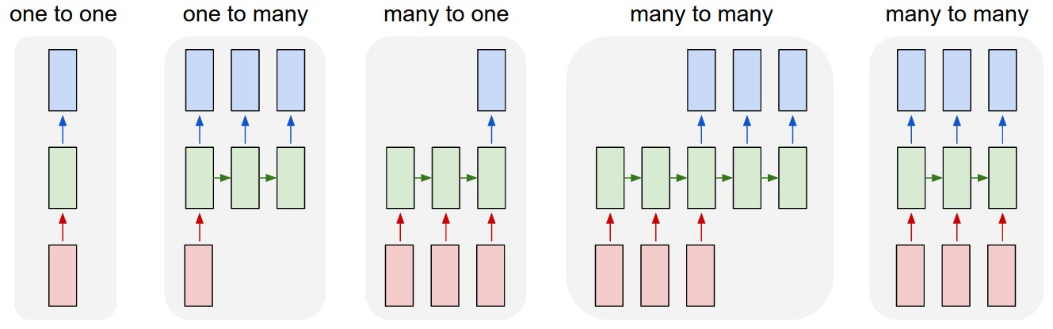
RNN Models
http://karpathy.github.io/2015/05/21/rnn-effectiveness/

Slide 9
RNN topics
RNN Basics
Teach RNN to say ‘hello’
One-hot VS embedding
RNN classification (name)
RNN on GPU
RNN language modeling
Teacher forcing
Sequence to sequence

Slide 10
RNN in PyTorch
cell = nn.LSTM(input_size=4, hidden_size=2, batch_first=True)
...
inputs = ... # (batch_size, seq_len, input_size) with batch_first=True
hidden = (... , ...) # (num_layers, batch_size, hidden_size)
# Bidirectional RNN*
hidden = (... , ...) # (num_layers*2, batch_size, hidden_size)
...
out, hidden = cell(inputs, hidden)

Slide 11
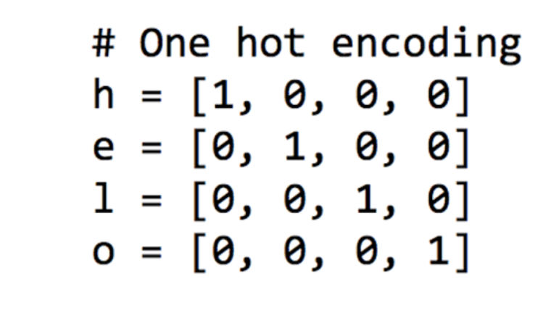
One hot encoding for letters, h, e, l, l, o

Slide 12
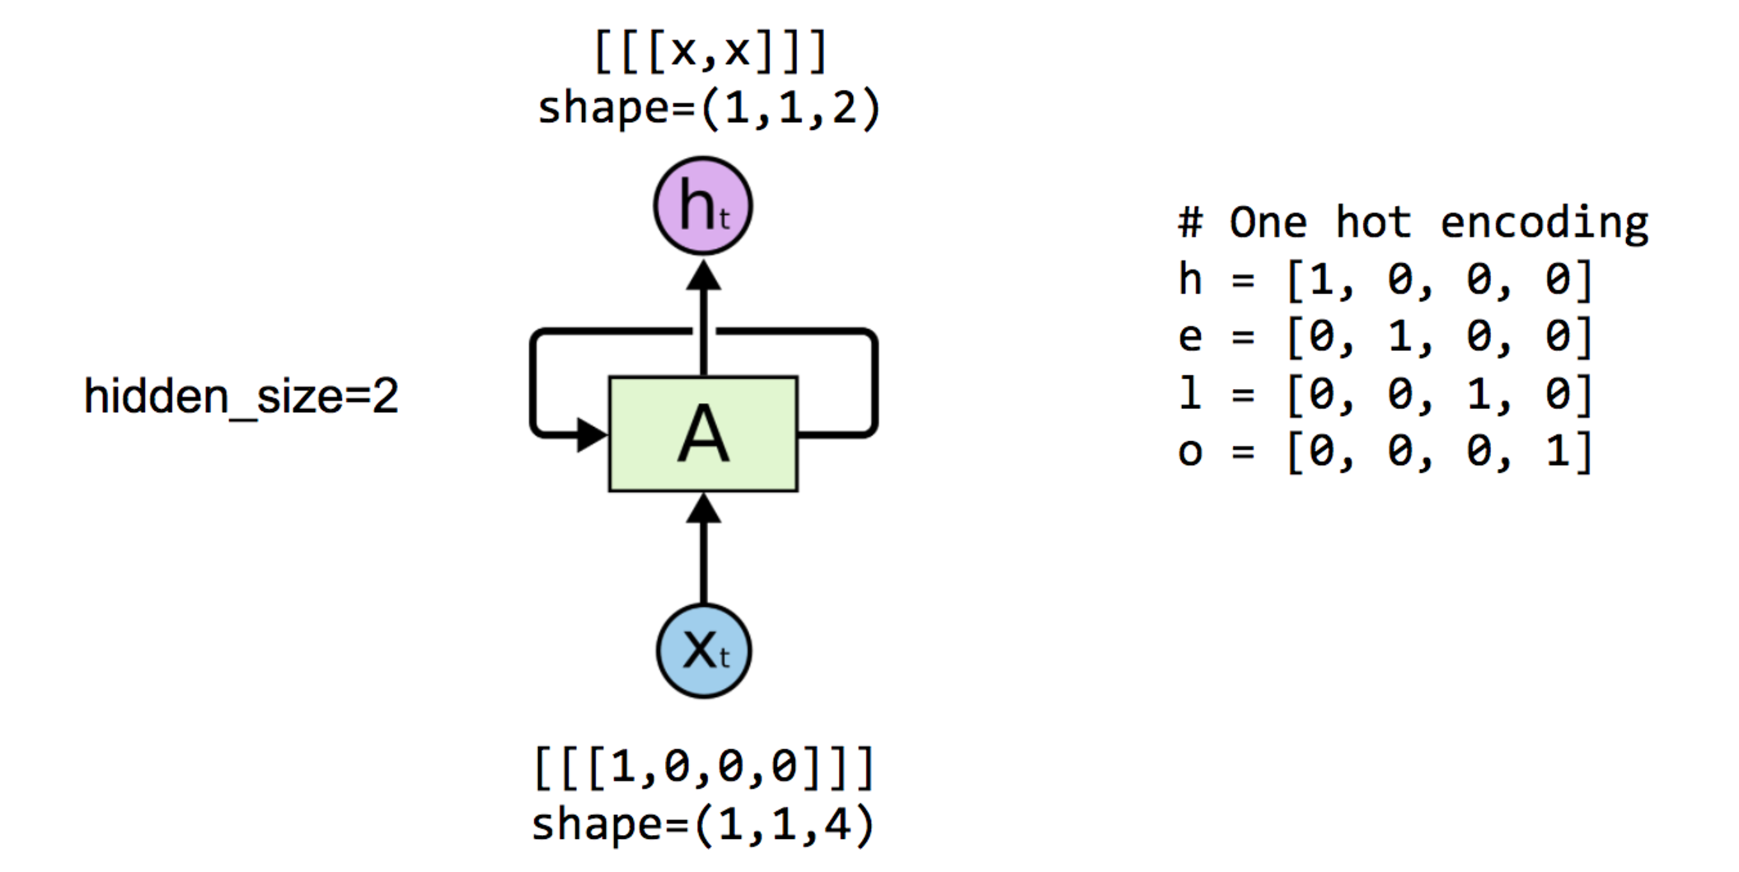
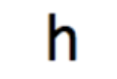
One node: 4 (input-dim) in 2 (hidden_size)

Slide 13
One node: 4 (input-dim) in 2 (hidden_size)

Slide 14
One node: 4 (input_dim) in 2 (hidden_size)
# One cell RNN input_dim (4) -> output_dim (2) cell = nn.LSTM(input_size=4, hidden_size=2, batch_first=True)
# One letter input
inputs = autograd.Variable(torch.Tensor([[h]])) # rank = (1, 1, 4)
# initialize the hidden state.
# (num_layers * num_directions, batch, hidden_size)
hidden = (autograd.Variable(torch.randn(1, 1, 2)),
autograd.Variable(torch.randn((1, 1, 2))))
# Feed to one element at a time.
# after each step, hidden contains the hidden state.
out, hidden = cell(inputs, hidden)
print("out", out.data)
-0.1243 0.0738
[torch.FloatTensor of size 1x1x2]

Slide 15
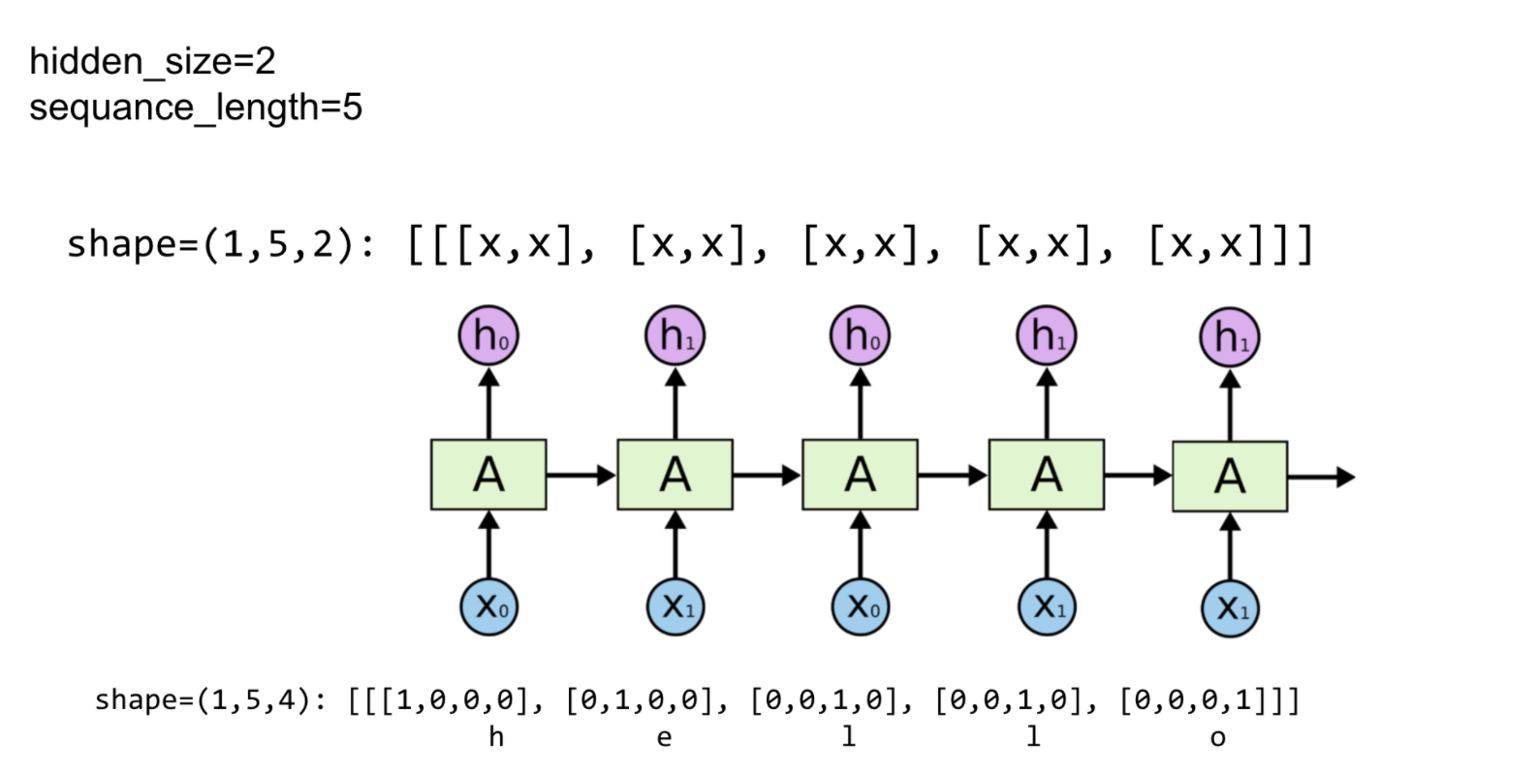
Unfolding to n sequences
hidden_size=2
seq_len=5
https://github.com/hunkim/DeepLearningZeroToAll/blob/master/lab-12-0-rnn_basics.ipynb

Slide 16
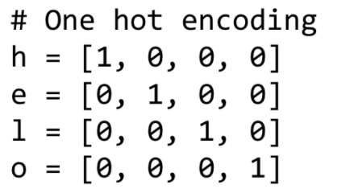
Unfolding to n sequences
# One cell RNN input_dim (4) -> output_dim (2). sequence: 5
cell = nn.LSTM(input_size=4, hidden_size=2, batch_first=True)
inputs = autograd.Variable(torch.Tensor([[h, e, l, l, o]]))
print("input size", inputs.size())
hidden = (autograd.Variable(torch.randn(1, 1, 2)), autograd.Variable(
torch.randn((1, 1, 2)))) # clean out hidden state
out, hidden = cell(inputs, hidden)
print(out.data)
input size torch.Size([1, 5, 4]) (0 ,.,.) = -0.1825 0.0737 -0.1981 0.1164 -0.3367 0.2095 -0.3625 0.2503 -0.2038 0.3626 [torch.FloatTensor of size 1x5x2]
hidden_size=2
seq_len=5
Notes:
CF: https://github.com/spro/practical-pytorch/blob/master/char-rnn-classification/char-rnn-classification.ipynb
for i in range(line_tensor.size()[0]): output, hidden = rnn(line_tensor[i], hidden)

Slide 17
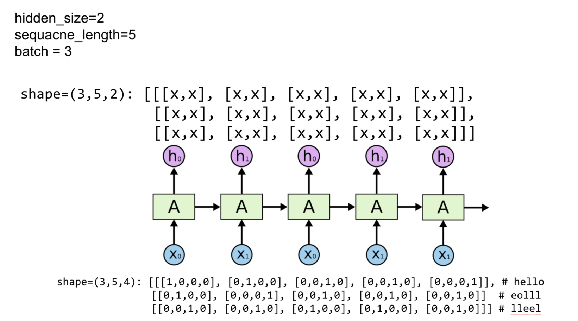
Batching input
Hidden_size=2
sequence_length=5
batch_size=3

Slide 18
Batching input
# One cell RNN input_dim (4) -> output_dim (2). sequence: 5, batch 3 # 3 batches 'hello', 'eolll', 'lleel' # rank = (3, 5, 4)
inputs = autograd.Variable(torch.Tensor([[h, e, l, l, o],
[e, o, l, l, l],
[l, l, e, e, l]]))
print("input size", inputs.size()) # input size torch.Size([3, 5, 4])
# (num_layers * num_directions, batch, hidden_size)
hidden = (autograd.Variable(torch.randn(1, 3, 2)), autograd.Variable(
torch.randn((1, 3, 2))))
out, hidden = cell(inputs, hidden)
print("out size", out.size()) # out size torch.Size([3, 5, 2])
Hidden_size=2
sequence_length=5
batch_size=3

Slide 19
Teach RNN ‘hihell’ to ‘ihello’
[1, 0, 0, 0, 0], # h 0
[0, 1, 0, 0, 0], # i 1
[0, 0, 1, 0, 0], # e 2
[0, 0, 0, 1, 0], # l 3
[0, 0, 0, 0, 1], # o 4

Slide 20
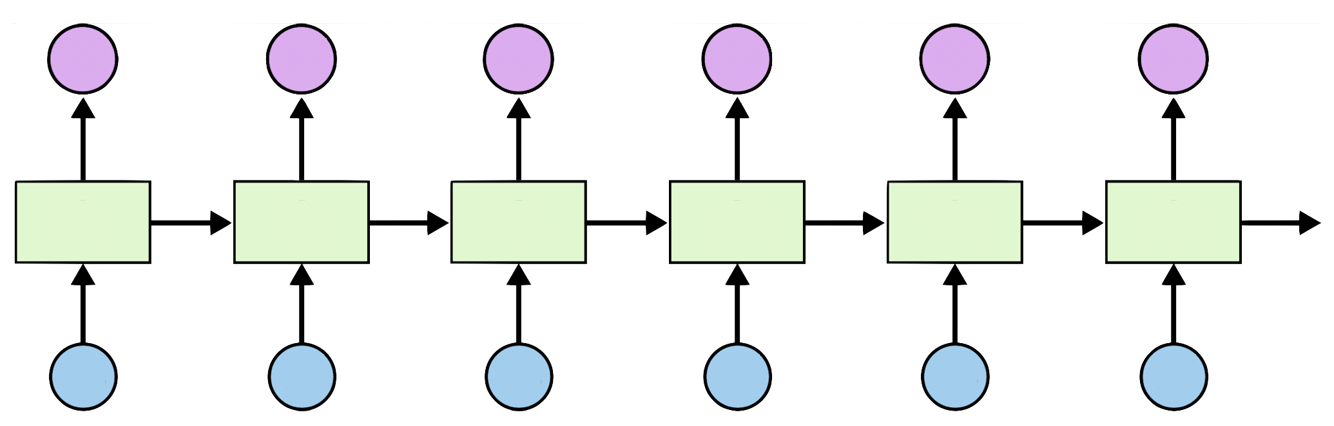
Teach RNN ‘hihell’ to ‘ihello’
[1, 0, 0, 0, 0], # h 0
[0, 1, 0, 0, 0], # i 1
[0, 0, 1, 0, 0], # e 2
[0, 0, 0, 1, 0], # l 3
[0, 0, 0, 0, 1], # o 4
output_dim = 5
[0, 1, 0, 0, 0]
[1, 0, 0, 0, 0]
[0, 1, 0, 0, 0]
[0, 1, 0, 0, 0]
[0, 1, 0, 0, 0]
[0, 0, 0, 0, 1]
i
h
e
l
l
o
h
i
h
e
l
l
[1, 0, 0, 0, 0]
[0, 1, 0, 0, 0]
[1, 0, 0, 0, 0]
[0, 1, 0, 0, 0]
[0, 1, 0, 0, 0]
[0, 1, 0, 0, 0]
Input_dim = 5

Slide 21

Loss and training
output_dim = 5
l (cross entropy)
[0.1, 0.6, 0.1, 0.1, 0.1]
h
i
h
e
l
l
[1, 0, 0, 0, 0]
[0, 1, 0, 0, 0]
[1, 0, 0, 0, 0]
[0, 1, 0, 0, 0]
[0, 1, 0, 0, 0]
[0, 1, 0, 0, 0]
Input_dim = 5

Slide 22
Loss and training
output_dim = 5
l
l
l
l
l
l
[0.1, 0.6, 0.1, 0.1, 0.1]
h
i
h
e
l
l
[1, 0, 0, 0, 0]
[0, 1, 0, 0, 0]
[1, 0, 0, 0, 0]
[0, 1, 0, 0, 0]
[0, 1, 0, 0, 0]
[0, 1, 0, 0, 0]
Input_dim = 5

Slide 23

Data preparation 1
idx2char = ['h', 'i', 'e', 'l', 'o']
# Teach hihell -> ihello
x_data = [[0, 1, 0, 2, 3, 3]] # hihell
x_one_hot = [[[1, 0, 0, 0, 0], # h 0
[0, 1, 0, 0, 0], # i 1
[1, 0, 0, 0, 0], # h 0
[0, 0, 1, 0, 0], # e 2
[0, 0, 0, 1, 0], # l 3
[0, 0, 0, 1, 0]]] # l 3
y_data = [1, 0, 2, 3, 3, 4] # ihello
# As we have one batch of samples, we will change them to variables only once
inputs = Variable(torch.Tensor(x_one_hot))
labels = Variable(torch.LongTensor(y_data))

Slide 24
Data preparation 2
idx2char = ['h', 'i', 'e', 'l', 'o']
# Teach hihell -> ihello
x_data = [0, 1, 0, 2, 3, 3] # hihell
one_hot_lookup =[[1, 0, 0, 0, 0], # 0
[0, 1, 0, 0, 0], # 1
[0, 0, 1, 0, 0], # 2
[0, 0, 0, 1, 0], # 3
[0, 0, 0, 0, 1]] # 4
y_data = [1, 0, 2, 3, 3, 4] # ihello
x_one_hot = [one_hot_lookup[x] for x in x_data]
# As we have one batch of samples, we will change them to variables only once
inputs = Variable(torch.Tensor(x_one_hot))
labels = Variable(torch.LongTensor(y_data))

Slide 25
(2) Parameters
num_classes = 5
input_size = 5 # one-hot size
hidden_size = 5 # output from the LSTM. 5 to directly predict one-hot
batch_size = 1 # one sentence
sequence_length = 1 # Let’s do one by one
num_layers = 1 # one-layer rnn

Slide 26
(3) Our model
class Model(nn.Module):
def __init__(self):
super(Model, self).__init__()
self.rnn = nn.RNN(input_size=input_size,
hidden_size=hidden_size, batch_first=True)
def forward(self, hidden, x):
# Reshape input in (batch_size, sequence_length, input_size)
x = x.view(batch_size, sequence_length, input_size)
# Propagate input through RNN
# Input: (batch, seq_len, input_size)
# hidden: (batch, num_layers * num_directions, hidden_size)
out, hidden = self.rnn(x, hidden)
out = out.view(-1, num_classes)
return hidden, out
def init_hidden(self):
# Initialize hidden and cell states
# (batch, num_layers * num_directions, hidden_size) for batch_first=True
return Variable(torch.zeros(batch_size, num_layers, hidden_size))
num_classes = 5
input_size = 5 # one-hot size
hidden_size = 5 # output from the LSTM.
batch_size = 1 # one sentence
sequence_length = 1
num_layers = 1 # one-layer rnn

Slide 27

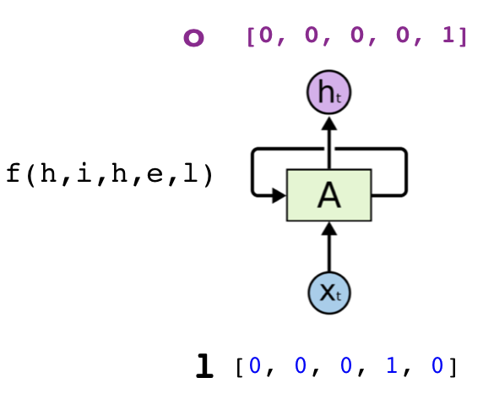
Designing Loss
Predict Y, one of five {h, i, e, l, o}
Linear
CrossEntropy
Some input: X

Slide 28
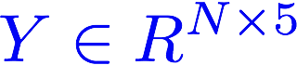
Designing Loss
out = rnn_out.view(-1, 5)
Predict Y, one of five {h, i, e, l, o}
Linear
CrossEntropy
Some input: X

Slide 29
(3) Our model
class Model(nn.Module):
def __init__(self):
super(Model, self).__init__()
self.rnn = nn.RNN(input_size=input_size,
hidden_size=hidden_size, batch_first=True)
def forward(self, hidden, x):
# Reshape input in (batch_size, sequence_length, input_size)
x = x.view(batch_size, sequence_length, input_size)
# Propagate input through RNN
# Input: (batch, seq_len, input_size)
# hidden: (batch, num_layers * num_directions, hidden_size)
out, hidden = self.rnn(x, hidden)
out = out.view(-1, num_classes)
return hidden, out
def init_hidden(self):
# Initialize hidden and cell states
# (batch, num_layers * num_directions, hidden_size) for batch_first=True
return Variable(torch.zeros(batch_size, num_layers, hidden_size))
num_classes = 5
input_size = 5 # one-hot size
hidden_size = 5 # output from the LSTM.
batch_size = 1 # one sentence
sequence_length = 1
num_layers = 1 # one-layer rnn

Slide 30
Designing Loss
out = rnn_out.view(-1, 5)
Predict Y, one of five {h, i, e, l, o}
CrossEntropy
criterion = nn.CrossEntropyLoss()
Some input: X

Slide 31
Unfolding one to n sequences

Slide 32
Teach RNN ‘hihell’ to ‘ihello’
[1, 0, 0, 0, 0], # h 0
[0, 1, 0, 0, 0], # i 1
[0, 0, 1, 0, 0], # e 2
[0, 0, 0, 1, 0], # l 3
[0, 0, 0, 0, 1], # o 4

Slide 33
Teach RNN ‘hihell’ to ‘ihello’
loss = 0
hidden = model.init_hidden()
sys.stdout.write("predicted string: ")
for input, label in zip(inputs, labels):
hidden, output = model(hidden, input)
loss += criterion(output, label)
print(", epoch: %d, loss: %1.3f" %
(epoch + 1, loss.data[0]))
loss.backward()
optimizer.step()

Slide 34
(4) Loss & Training
# Instantiate RNN model
model = Model()
# Set loss and optimizer function
# CrossEntropyLoss = LogSoftmax + NLLLoss
criterion = torch.nn.CrossEntropyLoss()
optimizer = torch.optim.Adam(model.parameters(), lr=0.1)
# Train the model
for epoch in range(100):
optimizer.zero_grad()
loss = 0
hidden = model.init_hidden()
sys.stdout.write("predicted string: ")
for input, label in zip(inputs, labels):
# print(input.size(), label.size())
hidden, output = model(hidden, input)
val, idx = output.max(1)
sys.stdout.write(idx2char[idx.data[0]])
loss += criterion(output, label)
print(", epoch: %d, loss: %1.3f" % (epoch + 1, loss.data[0]))
loss.backward()
optimizer.step()

Slide 35

(5) Enjoy the results
# Instantiate RNN model
model = Model()
# Set loss and optimizer function
# CrossEntropyLoss = LogSoftmax + NLLLoss
criterion = torch.nn.CrossEntropyLoss()
optimizer = torch.optim.Adam(model.parameters(), lr=0.1)
# Train the model
for epoch in range(100):
optimizer.zero_grad()
loss = 0
hidden = model.init_hidden()
sys.stdout.write("predicted string: ")
for input, label in zip(inputs, labels):
# print(input.size(), label.size())
hidden, output = model(hidden, input)
val, idx = output.max(1)
sys.stdout.write(idx2char[idx.data[0]])
loss += criterion(output, label)
print(", epoch: %d, loss: %1.3f" % (epoch + 1, loss.data[0]))
loss.backward()
optimizer.step()
epoch: 1, loss: 1.673 Predicted string: ehehee epoch: 2, loss: 1.403 Predicted string: ehehel epoch: 3, loss: 1.240 Predicted string: ehelll ...
epoch: 95, loss: 0.458
Predicted string: ihello
epoch: 96, loss: 0.458
Predicted string: ihello
epoch: 97, loss: 0.458
Predicted string: ihello
epoch: 98, loss: 0.458
Predicted string: ihello
epoch: 99, loss: 0.458
Predicted string: ihello
epoch: 100, loss: 0.458
Predicted string: ihello

Slide 36
RNN with a sequence
self.rnn = nn.RNN(input_size=5, hidden_size=5, batch_first=True)
[1, 0, 0, 0, 0], # h 0
[0, 1, 0, 0, 0], # i 1
[0, 0, 1, 0, 0], # e 2
[0, 0, 0, 1, 0], # l 3
[0, 0, 0, 0, 1], # o 4

Slide 37
(5) Enjoy the results
# Instantiate RNN model
rnn = RNN(num_classes, input_size, hidden_size, num_layers)
print(rnn)
# Set loss and optimizer function
# CrossEntropyLoss = LogSoftmax + NLLLoss
criterion = torch.nn.CrossEntropyLoss()
optimizer = torch.optim.Adam(rnn.parameters(), lr=0.1)
# Train the model
for epoch in range(100):
outputs = rnn(inputs)
optimizer.zero_grad()
loss = criterion(outputs, labels)
loss.backward()
optimizer.step()
_, idx = outputs.max(1)
idx = idx.data.numpy()
result_str = [idx2char[c] for c in idx.squeeze()]
print("epoch: %d, loss: %1.3f" % (epoch + 1, loss.data[0]))
print("Predicted string: ", ''.join(result_str))
print("Learning finished!")
for input, label in zip(inputs, labels):
# print(input.size(), label.size())
hidden, output = model(hidden, input)
val, idx = output.max(1)
sys.stdout.write(idx2char[idx.data[0]])
loss += criterion(output, label)

Slide 38
Exercise 12-1:
Implement using a softmax classifier for ‘hihell’ to ‘ihello’
Why does it not work?
Predict Y, one of five {h, i, e, l, o}
Linear
CrossEntropy
Some input: X

Slide 39

Exercise 12-2: Combine RNN+Linear
Why does it train faster (more stable)?
Linear
P(y=0)
P(y=1)
…
P(y=n)
Loss
With CrossEntropy

Slide 40
One hot VS embedding
2
index
One hot
[0, 0, 1, 0, 0]
One-hot: len (index)
x_one_hot = [[[1, 0, 0, 0, 0], # h 0
[0, 1, 0, 0, 0], # i 1
[1, 0, 0, 0, 0], # h 0
[0, 0, 1, 0, 0], # e 2
[0, 0, 0, 1, 0], # l 3
[0, 0, 0, 1, 0]]] # l 3

Slide 41
One hot VS embedding
Index (ex:2)
One hot
[0, 0, 1, 0, 0]
One-hot: len (index)
Index
(ex:2)
Embedding
(lookup table)
[0.2, 0.4, 0.6, 0.8, 0.5, 0.9]
Embedding
n size (typically 100~300)

Slide 42

One hot VS embedding
self.embeddings = nn.Embedding(vocab_size, output_size)
...
emb = self.embeddings(x)
Embedding
(Trainable
lookup table)
Vocab size (input size)
[0.2, 0.4, 0.6, 0.8, 0.5, 0.9]
Embedding size
(typically 100 to 300)
Embedding size (output size)

Slide 43
Exercise 12-3: Combine RNN+Linear using embedding
Linear
P(y=0)
Embedding
(lookup table)
P(y=1)
…
P(y=n)
Loss
With CrossEntropy

Slide 44
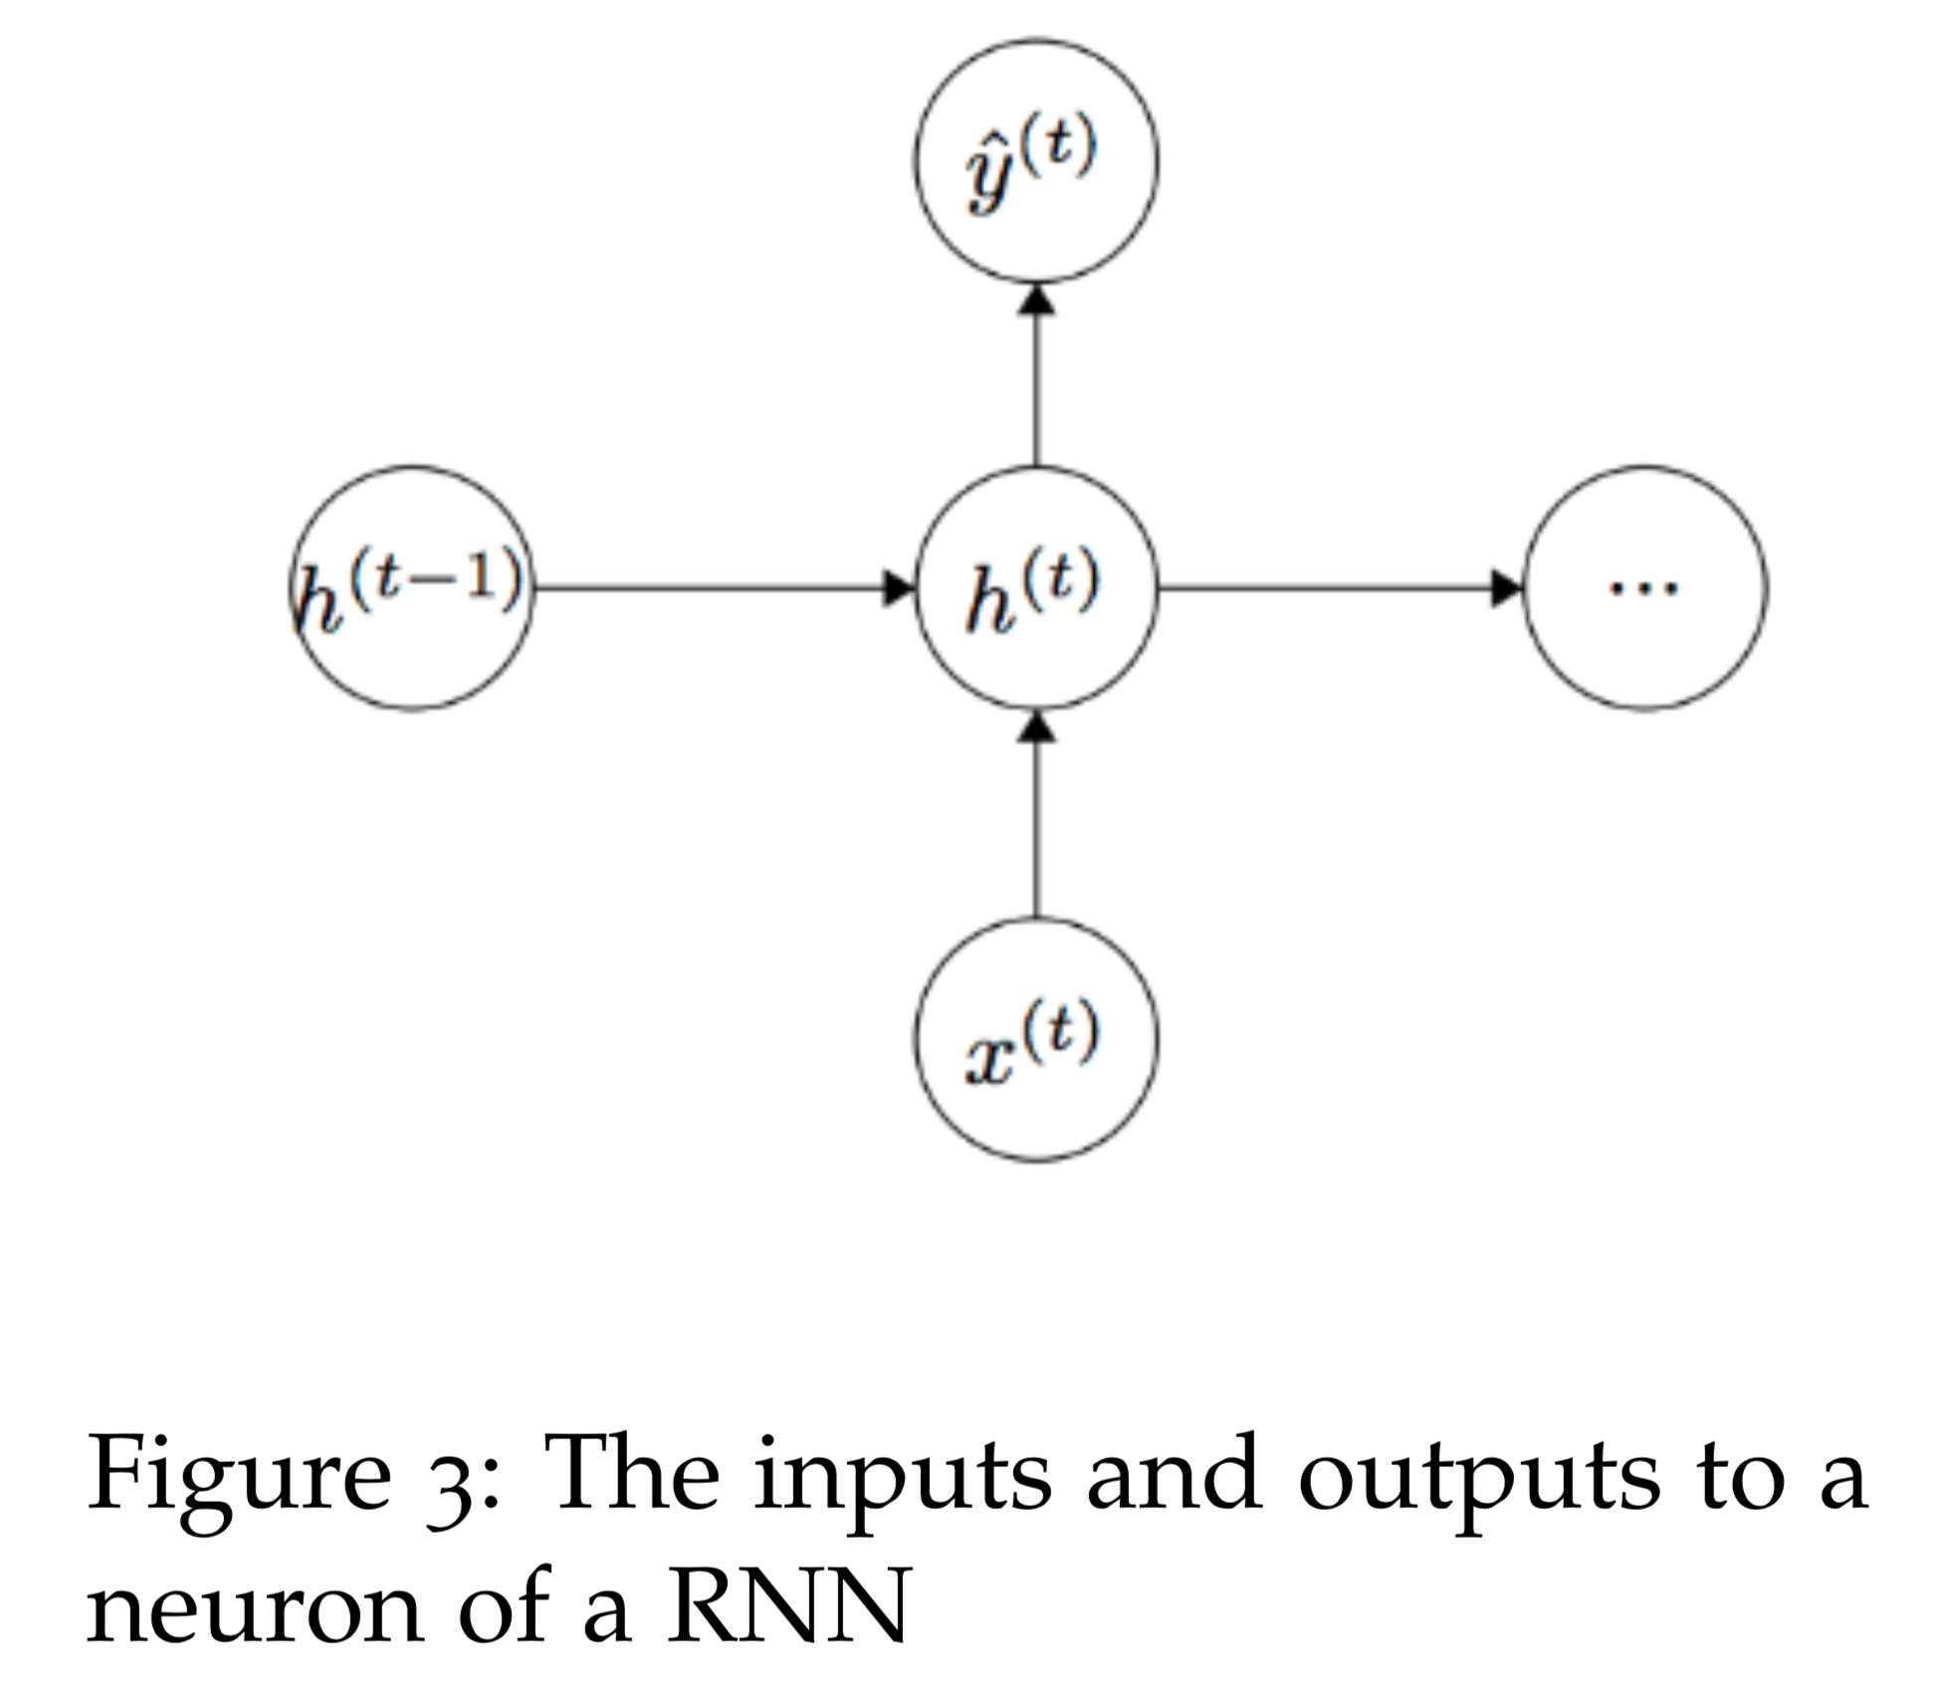
Under the hood: RNN
https://cs224d.stanford.edu/lecture_notes/LectureNotes4.pdf

Slide 45
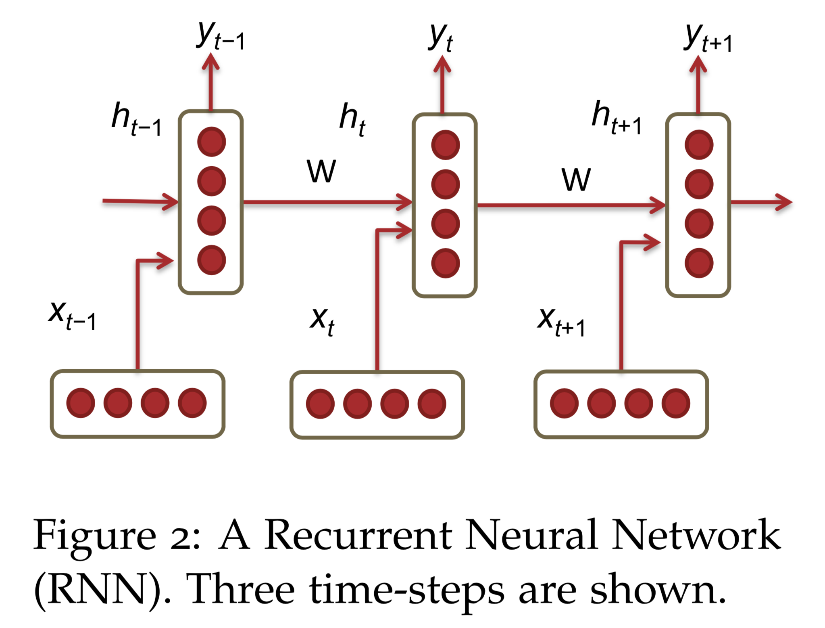
Under the hood: RNN
https://cs224d.stanford.edu/lecture_notes/LectureNotes4.pdf

Slide 46
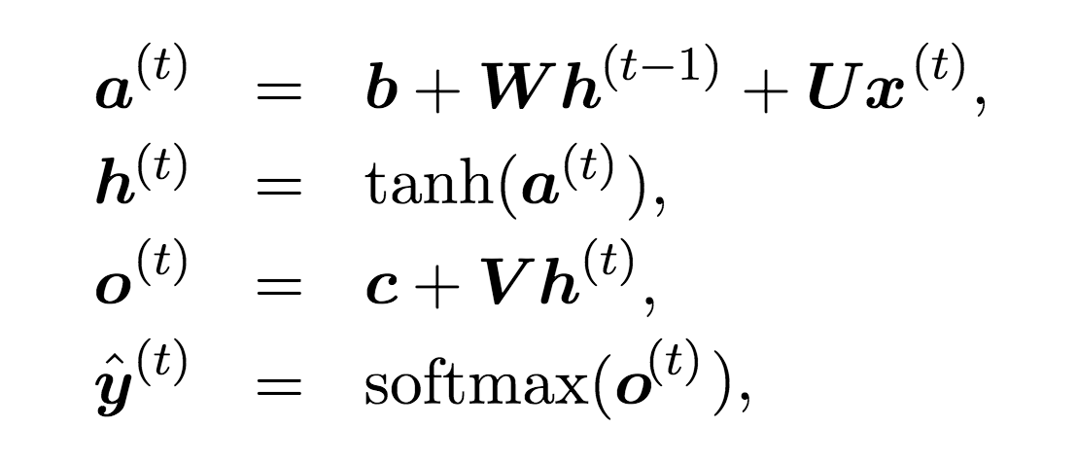
Under the hood: RNN
https://cs224d.stanford.edu/lecture_notes/LectureNotes4.pdf

Slide 47
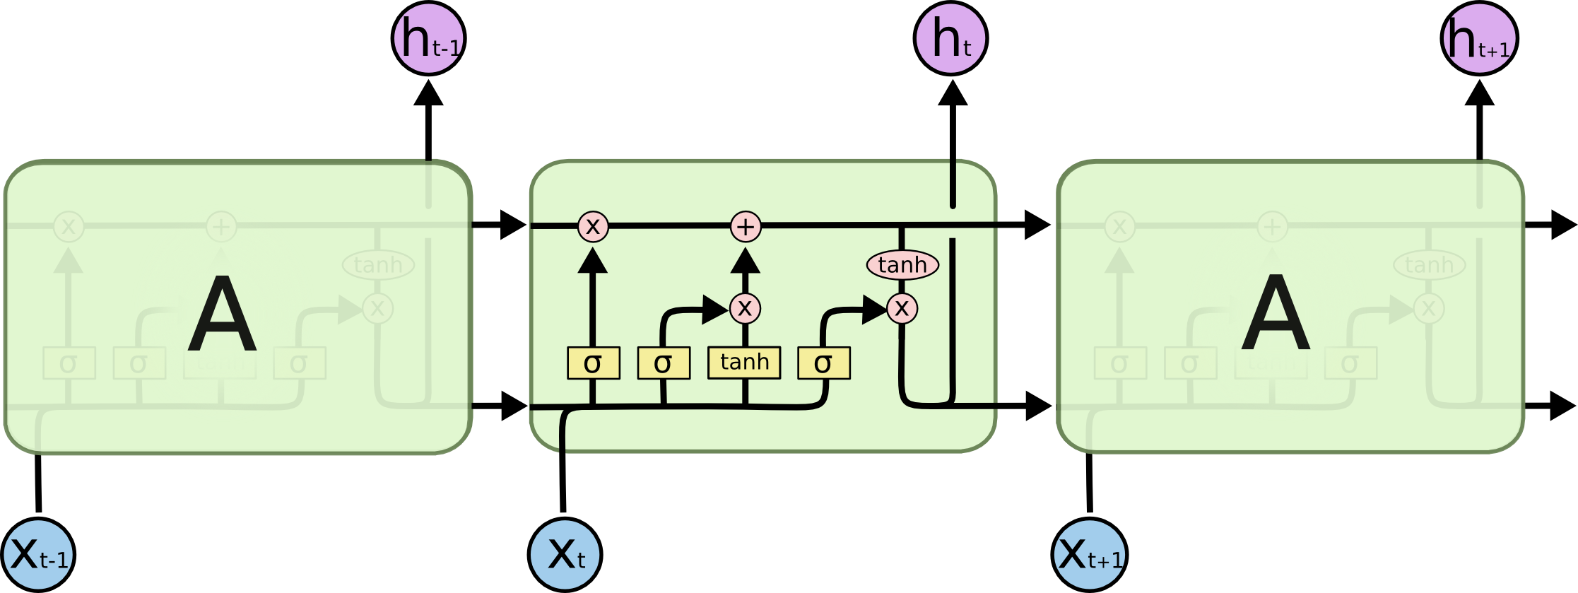
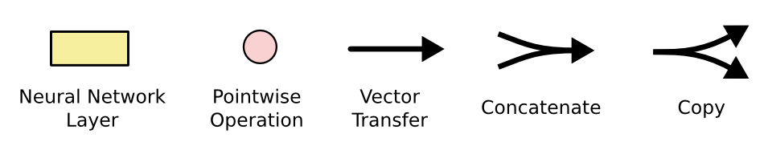
Under the hood: LSTM
http://colah.github.io/posts/2015-08-Understanding-LSTMs/

Slide 48
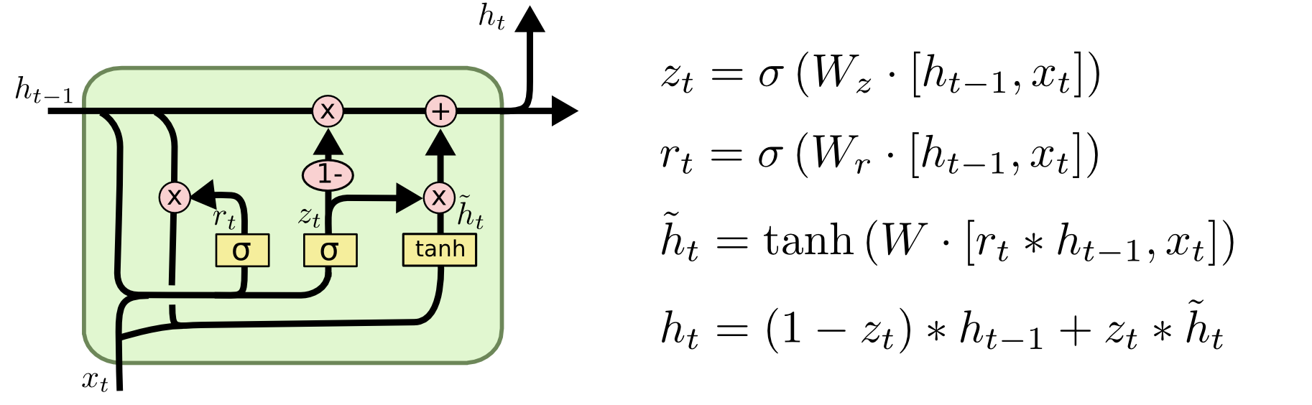
Under the hood: GRU
http://colah.github.io/posts/2015-08-Understanding-LSTMs/

Slide 49
Exercise 12-5: Implement RNN
Hint: http://blog.varunajayasiri.com/numpy_lstm.html
https://cs224d.stanford.edu/lecture_notes/LectureNotes4.pdf

Slide 50
Exercise 12-5: Implement RNN
class RNN(nn.Module): def __init__(self, input_size, hidden_size): super(RNN, self).__init__() self.input_size = input_size self.hidden_size = hidden_size ... def forward(self, input, hidden): hidden = ... output = ... return output, hidden rnn = RNN(...)

Slide 51
Exercise 12-6: Implement GRU
http://blog.varunajayasiri.com/numpy_lstm.html
http://www.wildml.com/2015/10/recurrent-neural-network-tutorial-part-4-implementing-a-grulstm-rnn-with-python-and-theano/

Slide 52


Lecture 13: RNN II

